Slide 1
MASTERPIECES OF WESTERN ART Art Humanities W1121 Section 15
The Parthenon
(Part 3)

Slide 2
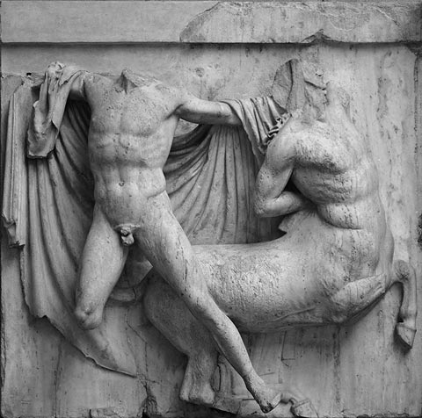
Parthenon
Metope #27

Slide 3
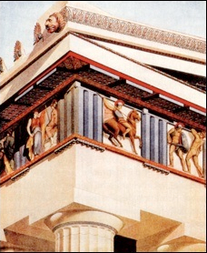
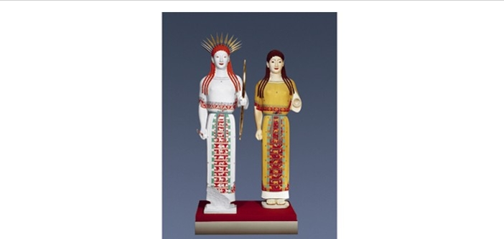
Polychromy in Greek sculpture
Examples of colored reconstructions
Parthenon metope
“Peplos” Kore
Originals:
c. 530 B.C.

Slide 4
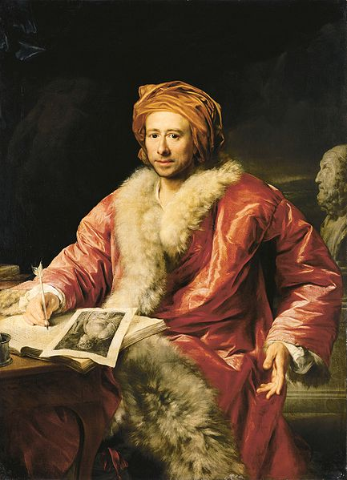
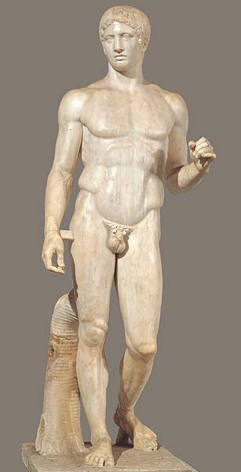
“a noble simplicity and calm grandeur”
Anton von Maron
Portrait of Johann Joachim Winckelmann, 1768
Roman copy of
Polycleitos’ Doryphoros

Slide 5
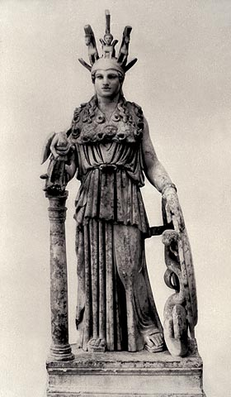
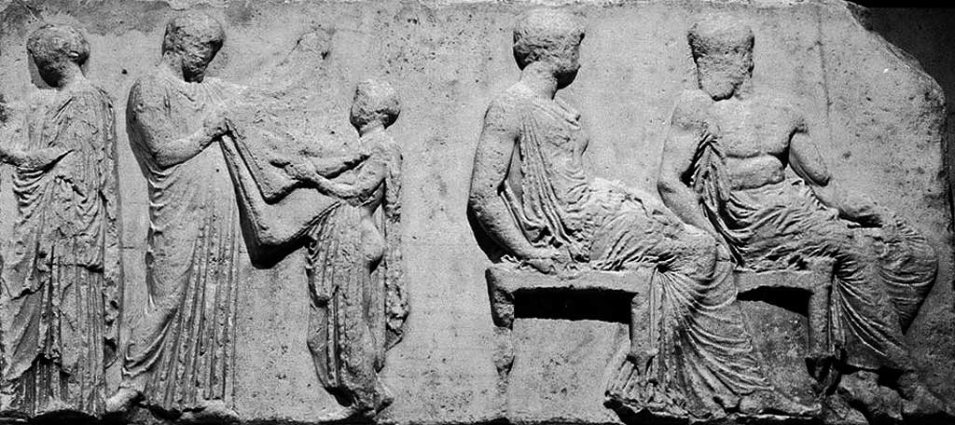
Ionic frieze: the Panathenaic Procession
Ritual act with the robe (peplos) of Athena; seated god and goddess identified as Athena and Hephaistos
Phidias, Athena Parthenos
Roman copy

Slide 6
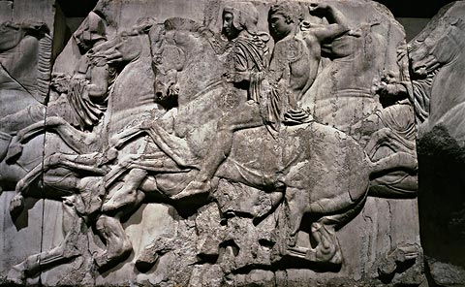
Horesmen

Slide 7
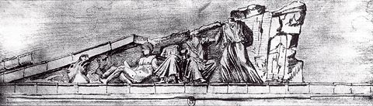
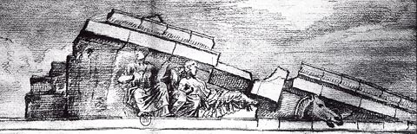
Jacques Carrey, drawings of the left and right sides of the
East pediment of the Parthenon, 1674

Slide 8
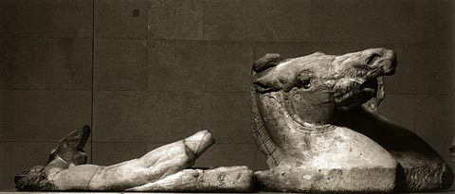
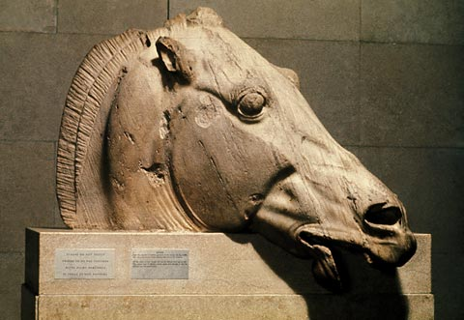
Helios and head of horses
from his chariot
Head of a horse from the chariot of
Selene sinking into the waters
of Okeanos

Slide 9
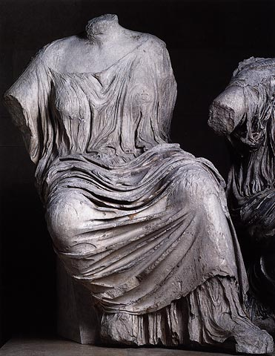
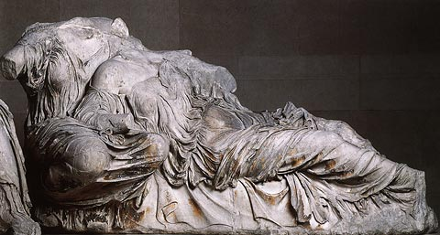
The Three Fates, or Hestia, Dione and Aphrodite?

Slide 10
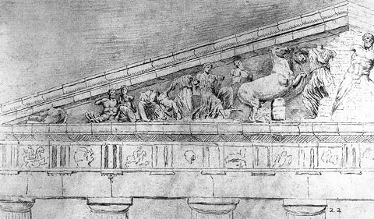
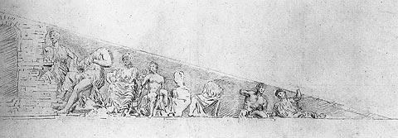
Jacques Carrey, drawings of the left and right sides of the
West pediment of the Parthenon, 1674

Slide 11
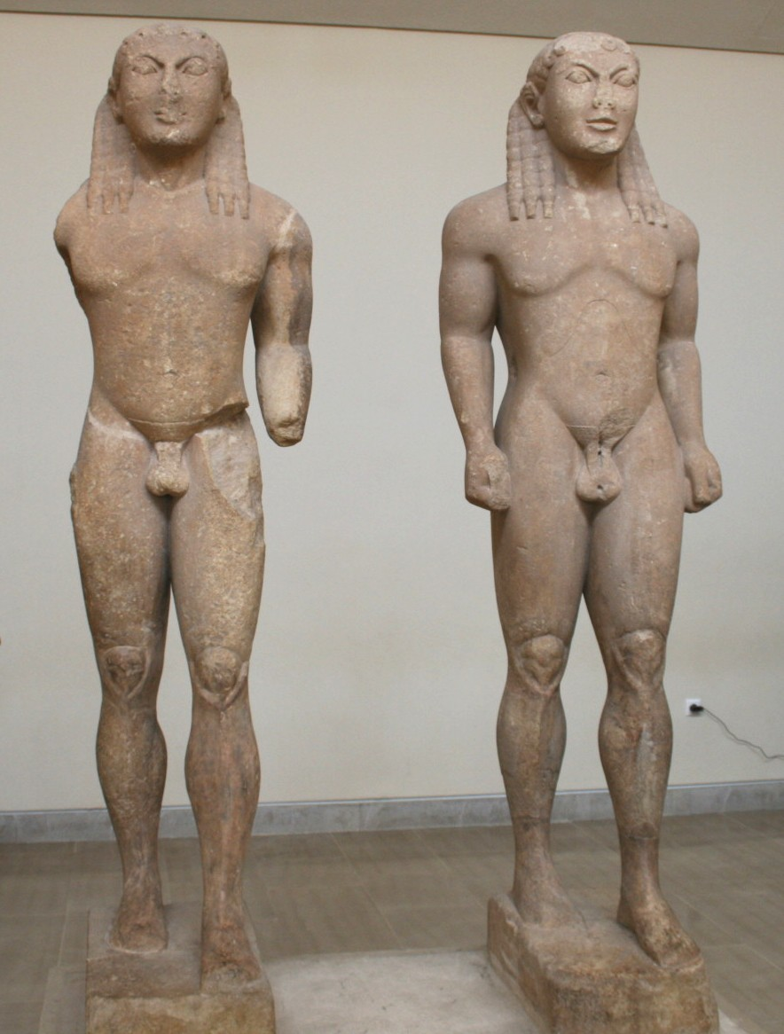
Twins of Argos
c. 580 B.C.
Roman copy of Polycleitos’ Doryphoros
Original c. 440 B.C.

Slide 12
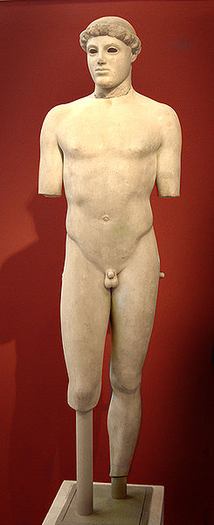
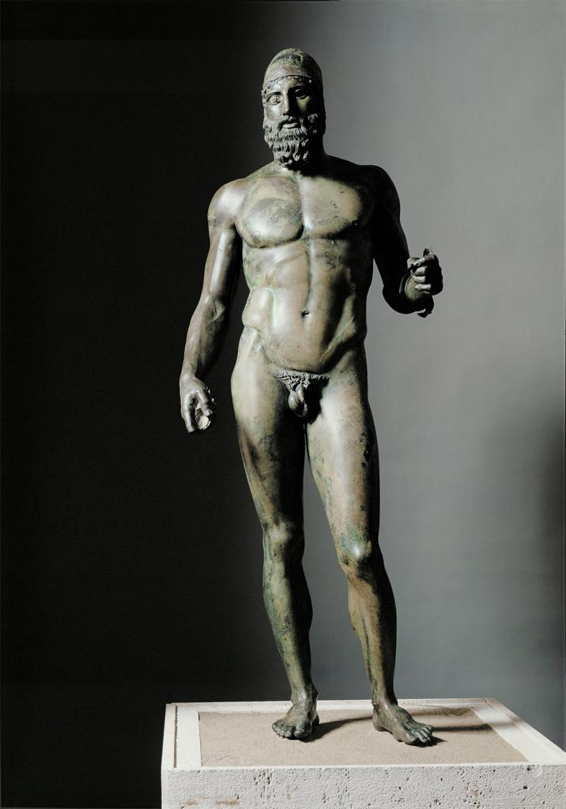

Slide 14
580 B.C.
480 B.C.
460-430 B.C.
440 B.C.

Slide 15
Ephebe known as “Kritios Boy”
c. 480 B.C.
Marble, 3’8’’ (Acropolis Museum, Athens)
Young Man with Helmet known as “Riace Bronze”
c. 460-430 B.C.
Bronze, 6’4’’ (National Museum, Reggio Calabria)

Slide 16
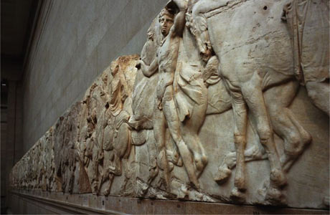
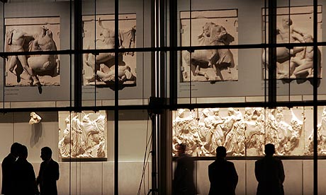
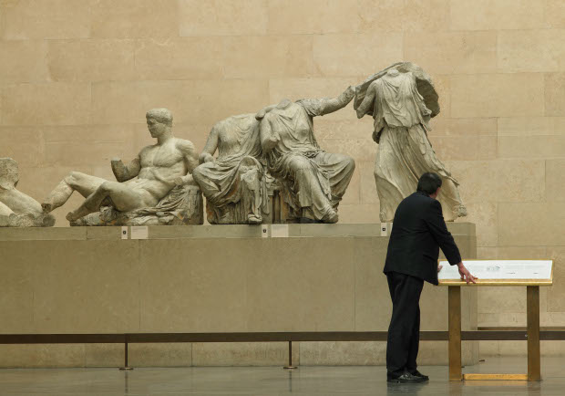
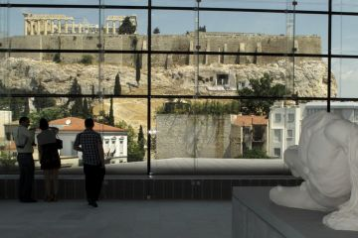
The “Elgin Marbles” debate
British Museum, London
Acropolis Museum, Athens

Slide 17
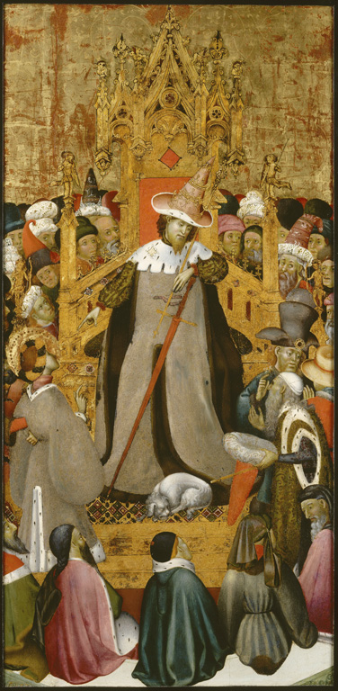
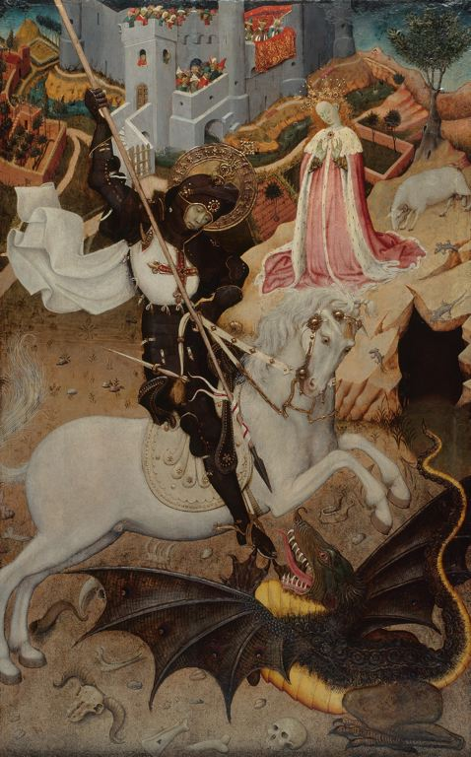
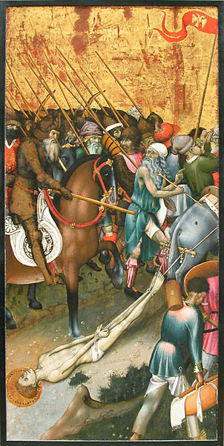
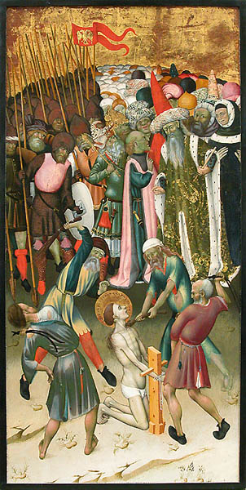
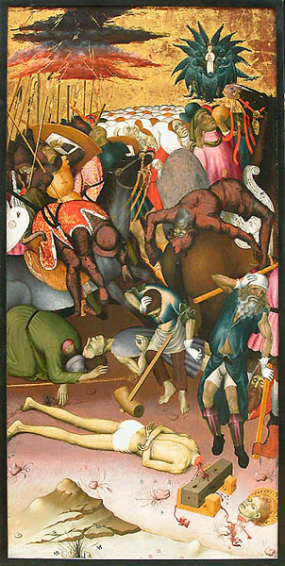
Bernardo Martorell, Altarpiece of the Legend of Saint George, c. 1434-1435
Louvre, Paris
Art Institute, Chicago
Louvre, Paris

Slide 18
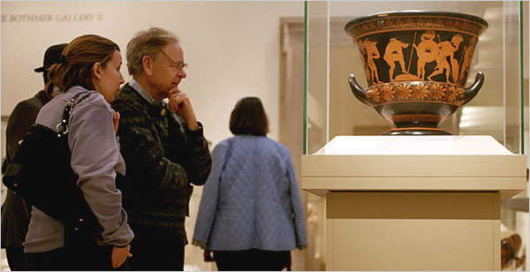
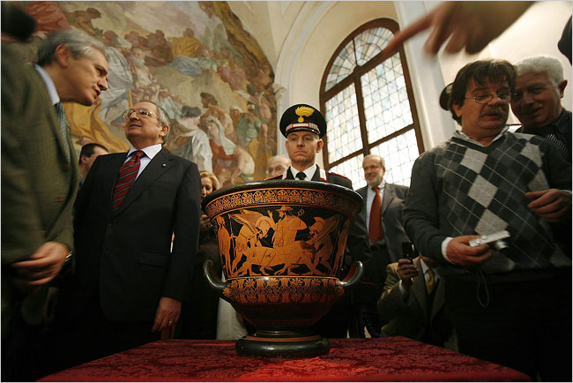
6th-century B.C. Greek krater exhibited at the
Metropolitan Museum,
New York
Journalists and officials
celebrating the return of the
krater in Rome
(Both photographs from the New York Times)

